Slide 1
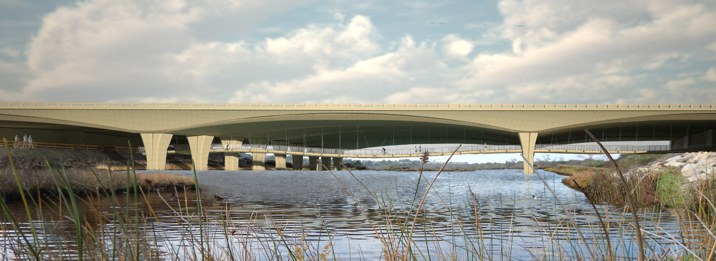
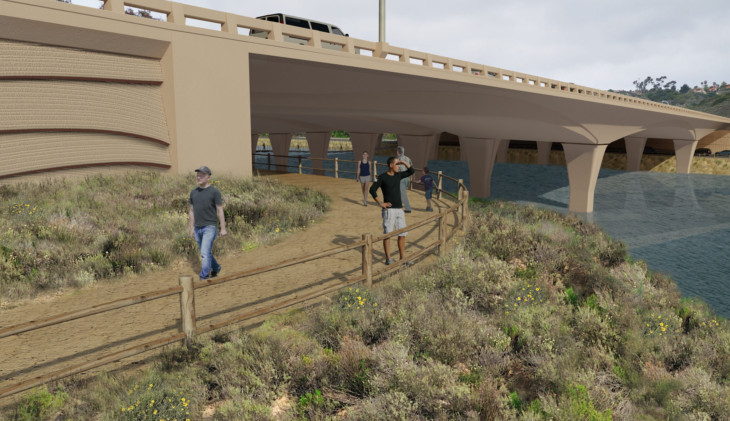
San Elijo Lagoon Highway Bridge
Planned San Elijo Lagoon Highway Bridge
Planned San Elijo Lagoon Pedestrian Path
Planned San Elijo Lagoon Bike/Pedestrian Bridge Path

Slide 2
San Elijo Lagoon Highway Bridge
Widening the bridge will accommodate one new carpool lane along I-5 in each direction
Lengthening the bridge will improve tidal flow and overall lagoon health
Bridge will include a new bike/pedestrian suspended bridge that will link the south and north sides of the lagoon
Construction Timeline: - Begin Early 2017 - Complete 2021
Bridge is being built to its ultimate width to accommodate long-term improvements, including second carpool lane in each direction and a Direct Access Ramp from Manchester Avenue (planned for 2035)

